Slide 1
Iteration Management – Your Key to Predictable Delivery
By Jon Kruger
(@JonKruger)

Slide 2
What is Iteration Management?
Notes:
Iteration managers vs. project managers
Optimize efficiencies – let team members focus
Help the team work as a team (not silos)
Unblocker
How to spot someone being blocked
Handling changes (from the business, production support, etc.)

Slide 3
What if I’m not an Agile project?
Notes:
You don’t have to be in an Agile environment to do these things, although Agile practices make this a lot easier
Apply these ideas to the work that you are doing so that you can see problems quicker

Slide 4
What if I’m not a team lead?
Notes:
Think of yourself as a team of one – apply principles

Slide 5
What’s an iteration?
Notes:
Small, defined amount of time (scrum)
Continuous flow of work (kanban)

Slide 6
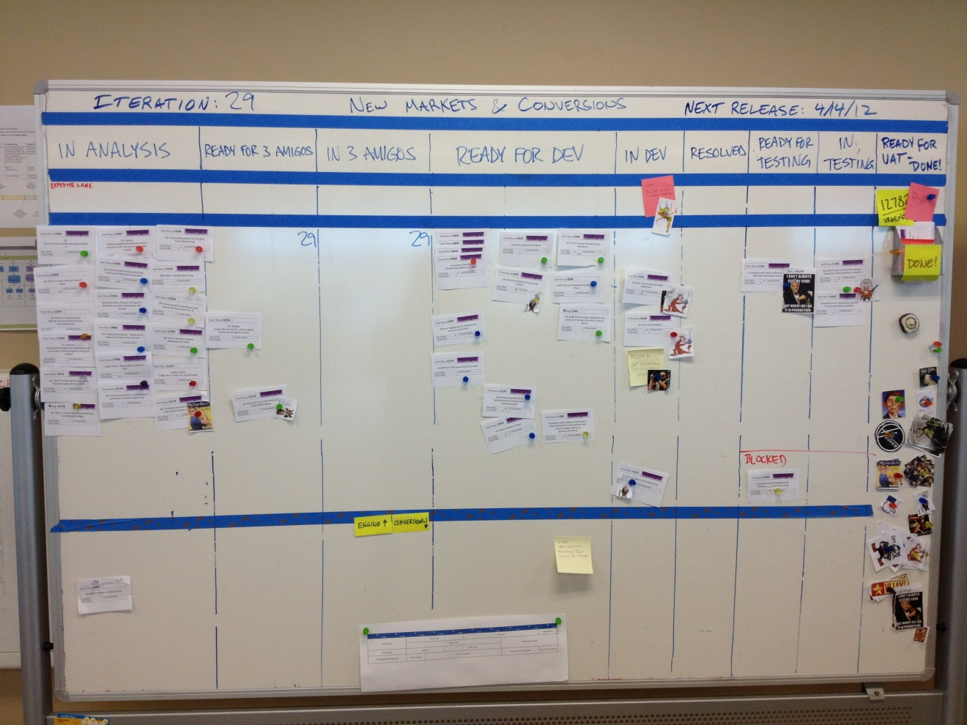
The Board
Notes:
Physical board vs. online tools

Slide 7
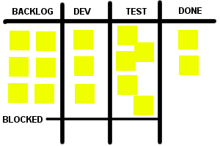
What is this board telling you?
Notes:
In this example, we can easily see that we are either developing things faster than we can test them, or things are getting stuck in testing due to bugs. We may need to assign more people to testing or work on reducing bugs.

Slide 8
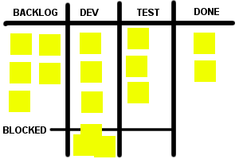
What is this board telling you?
Notes:
There are a lot of features that are blocked. We should try and address the blocking issues and look and see if there is some greater problem that is causing things to get blocked.

Slide 9
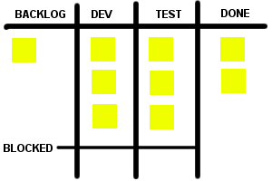
What is this board telling you?
Notes:
We don’t have much in our backlog, so the developers are going to be out of stuff to do really soon. We may need to get more people working on requirements gathering.

Slide 10
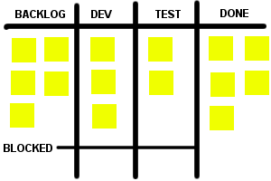
What is this board telling you?
Notes:
Things are flowing pretty smoothly. We have a good sized backlog, no blockers, the work is evenly distributed, and we’re getting a lot done.

Slide 11
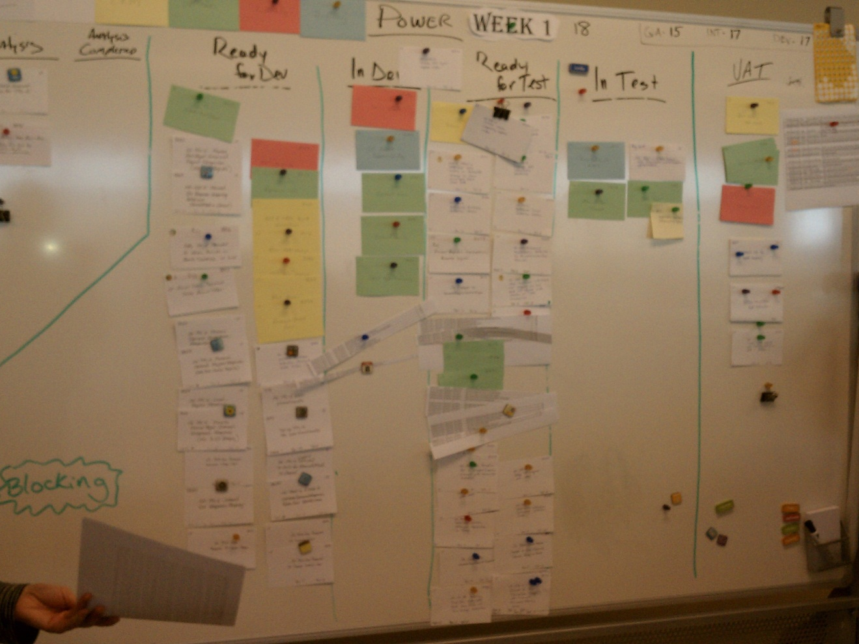
What is this board telling you?

Slide 12
Managing the Iteration
Notes:
Board
Online tools

Slide 13
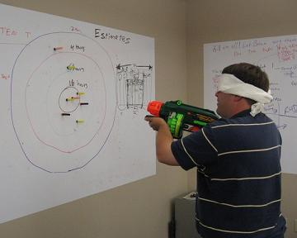
Estimating
Notes:
“Estimates are always wrong” – business needs better that this
You know that estimates will be interpreted as commitments, this should not surprise you anymore
Small tasks are easier to estimate (how small is up to you)
3 amigos
People doing the work should do the estimates
Estimate as late as possible
Re-estimating work that was estimated long ago
Don’t have long estimation meetings
Story points vs. hours

Slide 14
Estimation Methods
Time (hours/days)
Story Points
Counting tickets
No estimating
Notes:
Pros and cons of each

Slide 15

How many in the jar?

Slide 16

How many in the jar?
250

Slide 17

How many in the jar?
250
90
Notes:
It becomes much easier to estimate once we have data that can help us determine the right answer.

Slide 18
Data Analysis
Notes:
Past experiences with data analysis
Get better at estimating
How will you know if you’re estimating correctly?
Control variables
Team members
Smaller teams
Expected the unexpected
Consistent hours/accounting for all hours
Track everything!
Tracking estimates vs. actuals

Slide 19
Metrics

Slide 20
Burndown Charts

Slide 21
Capacity Planning
Notes:
How much can we commit to, and what should we work on?
Tickets should already be estimated (incl. analysis, testing)
% person’s time in each discipline for moving tickets? (separate by project)
Account for time off, special meetings, etc.
Expected time needed for new scope, prod support, etc.
Normal working hours
Break the team into smaller teams (or sub-teams)
Each sub-team can do their own capacity planning
Start with a gut feel, and then adjust your gut feel estimate based on data and experiences (PUT THIS POINT SOMEWHERE ELSE?)

Slide 22
Involving Stakeholders
Notes:
Product owners
Let the business pick what you work on
Include the business in the meeting, or meet with the before, whatever works
Set goals for the iteration
Swapping things out during the iteration
Demos/UAT

Slide 23
Managing the Backlog

Slide 24
Working with Management

Slide 25
Keeping Up

Slide 26
The only rule
Do more of what works and less of what doesn’t.

